Slide 1
HV Permits Update and Discussion

Slide 2
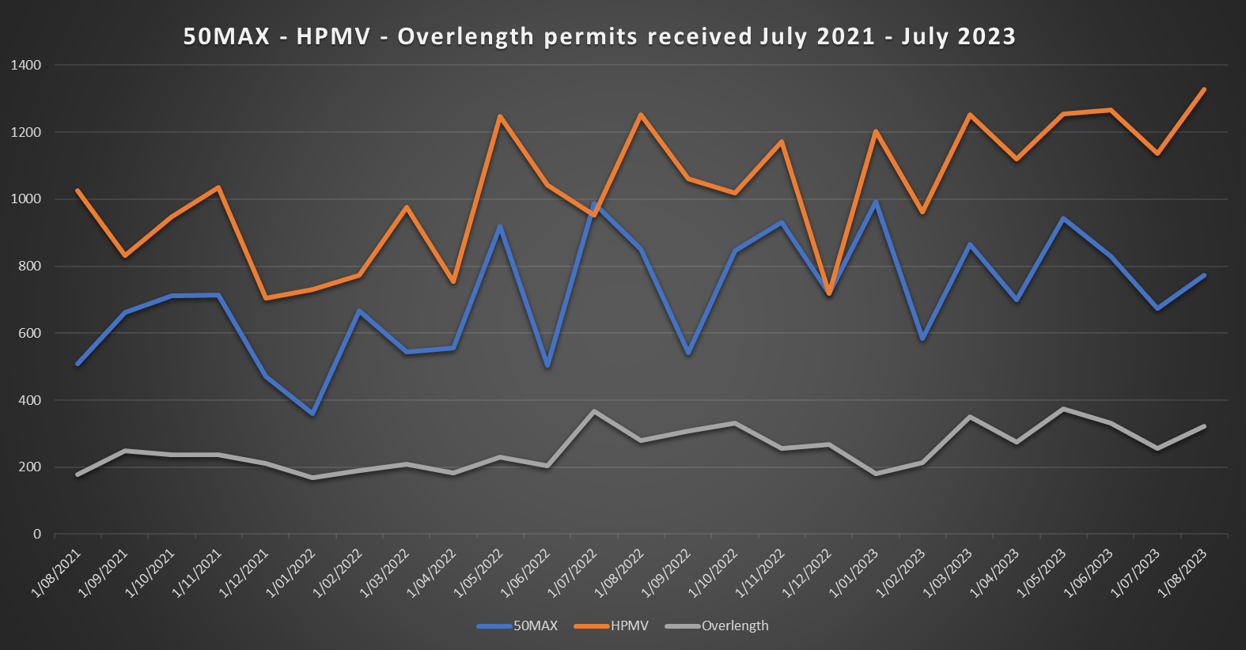
Monthly Permit volumes
Continuing to see growth in HPMV Higher Mass and 50MAX
Increase in new builds (overlength permits) as components come back in from overseas

Slide 3
Compliance Activities 22/23
Permits have been revoked / declined due to travel on unauthorised structures, excess weight, vehicle standards, outstanding debt
We continue to work across all areas of regulatory, with increased focus on RUC

Slide 4
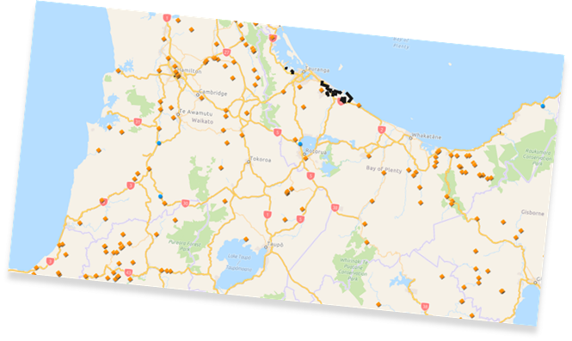
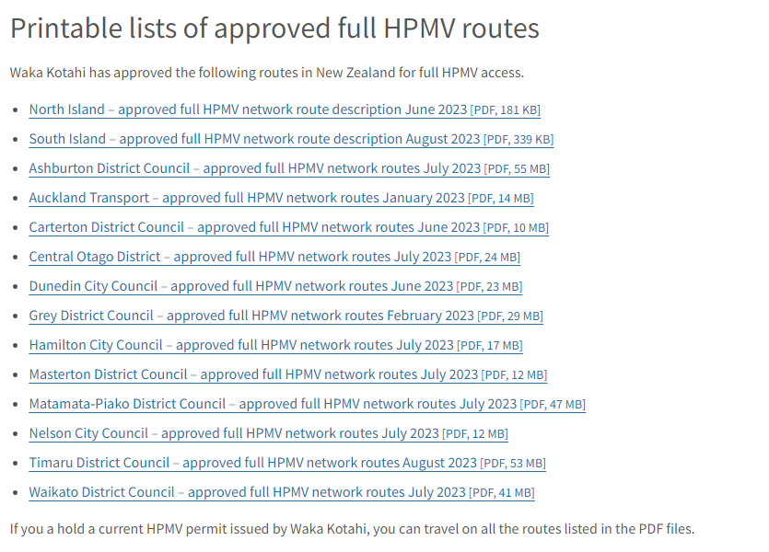
Permitting Networks
50MAX
Grey DC added
Westlands soon
Full HPMV
SH Network Map Established (70% access)
12 councils have signed up and pdf list of roads available
+/-98% of access to Local Councils
Digital Full map in developement

Slide 5
Opportunities and feedback
Removal of attribute sheets for OL and 50MAX and HPMV
Extending the number of combinations to 10 per application, initially 50MAX
Extend the validity of permits to 3/5 years
Explore the 54T network opportunity- SH network screened and 94% accessible
Explore a container network
Centralised Permit Service
Application initiation on VIN

Slide 6
Permit Platform
Move to new Permit processing platform in August 2022
50MAX renewal as of August 2022
50MAX new came on board from the end of September 2022
Approx 10 minutes per application time saving
All compliance checks done via platform – operator view
New permit template in effect from 22 November 2022 – there will be 3 x variations of 50MAX permits all are valid
Over Dimension permits added to the platform April 2023 (including Load Pilots & Load Notifications)

Slide 7
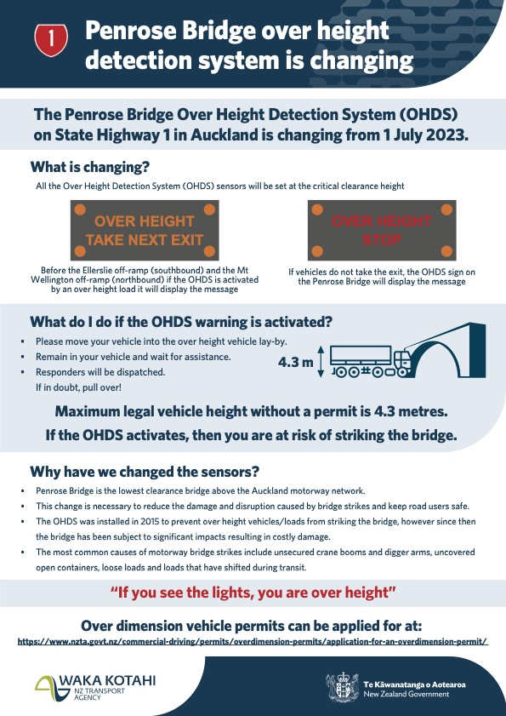

Slide 8
Permit Fee Changes
Changes to many fees for vehicle licensing and registration
Increasing the amount paid to renew rego (vehicle licence) and to register a vehicle for the for the first time
Decreasing the amount paid to re-register a vehicle (previously cancelled/lapsed)
https://www.nzta.govt.nz/regulatory/changes-to-regulatory-funding-fees-and-charges/fees-and-charges/

